Slide 1
Status of Observing Strategy Optimized for Supernova Cosmology: White paper and more
Authors: Jeonghee Rho (SETI Institute and NASA Ames)
Raul Biswas
Micelle Lochner
Contributors: Saurabh Jha, Michael Wood-Vasey, Alex Kim, Christopher Stubbs, Pierre Antilogus, Ryan Foley, Zeljko Ivezic, Jeffery Newman, and Eric Gawiser +++

Slide 2
OpSim Analysis
Deep Drilling Survey (DDF)
Wide field Survey (WFD)
Light curves: assumed z = 0.5 (focus on WFC)
May explore other z values
Position of sky: RA, Dec ➔ FieldID
Y-axis: Flux (not mag)
E(B-V) is fitting parameter (using Rv=3.1)
MJD day Peak (time=0, explosion day) is determined based on Light curve

Slide 3
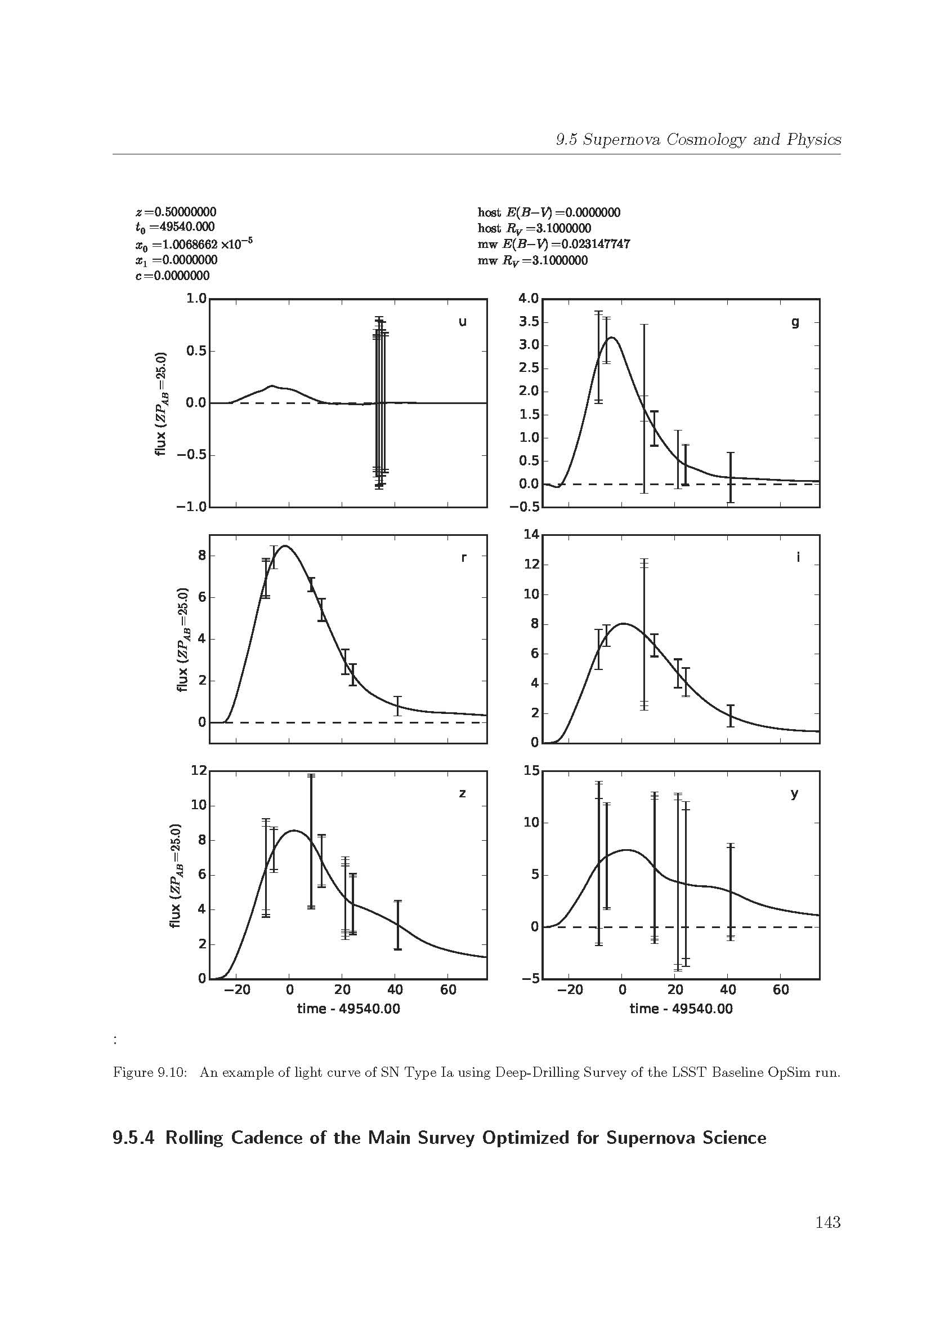
Deep Drilling Field Field ID = 290 Dec =63.321 ° RA =349.386° Some deep fields may be better SNDM=1 SNQM=1 SNCLASS Data have good quality: >7-9 points per filter per SNIa LC period
Group A

Slide 4
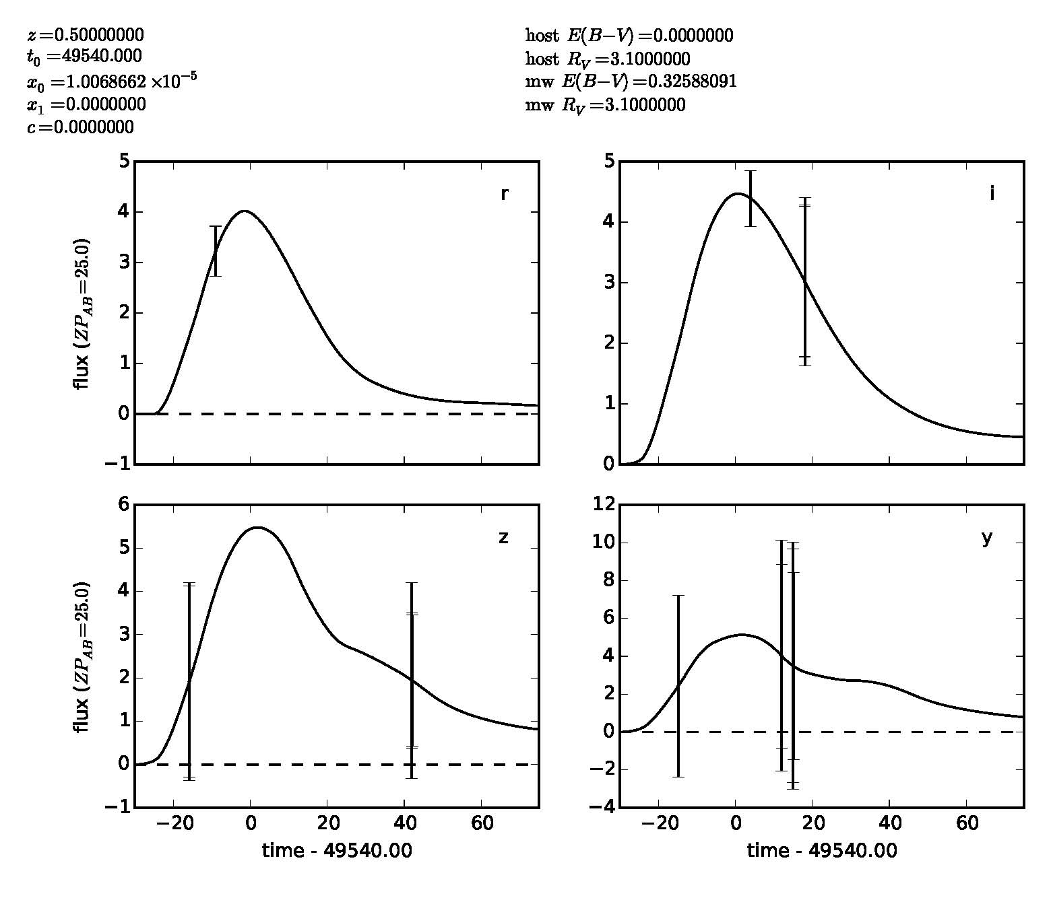
Field ID = 309 Dec =63.321 ° RA =349.386° SNDM~1 SNQM(Ia)=0.1
Avg. Data points per filter: 2
Only 4 band detection
total 9-14 points
The data points are insufficient predict the LC.

Slide 5
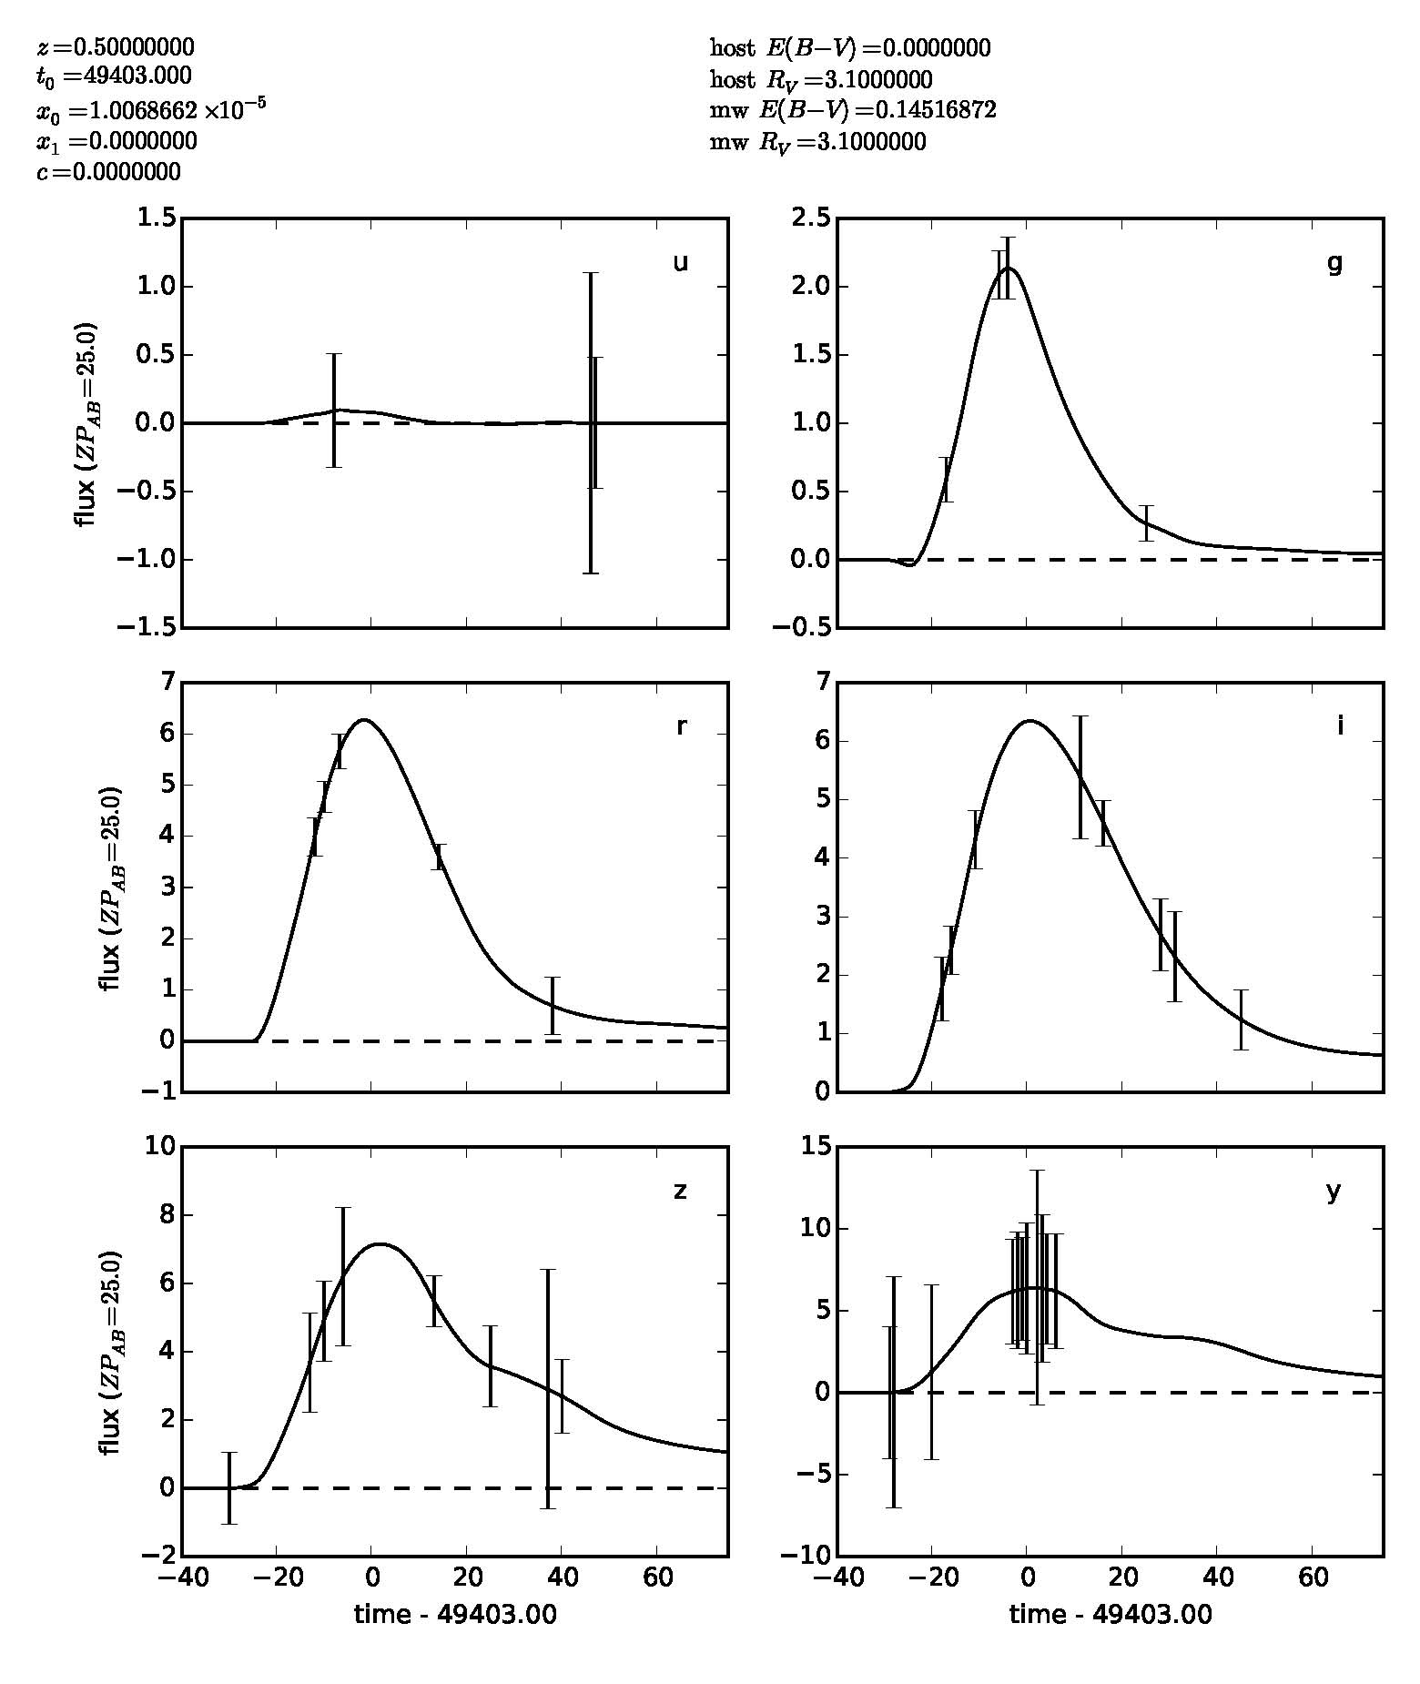
Dec = -66° RA = 115°

Slide 6
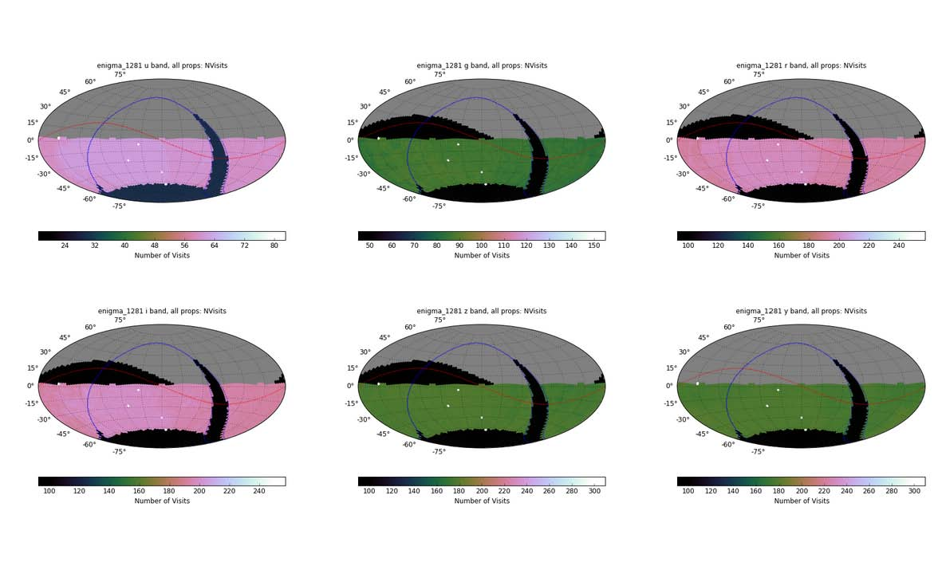
N visits
u(60)
g(85)
r(200)
z(170)
y(170)
i(200)

Slide 7
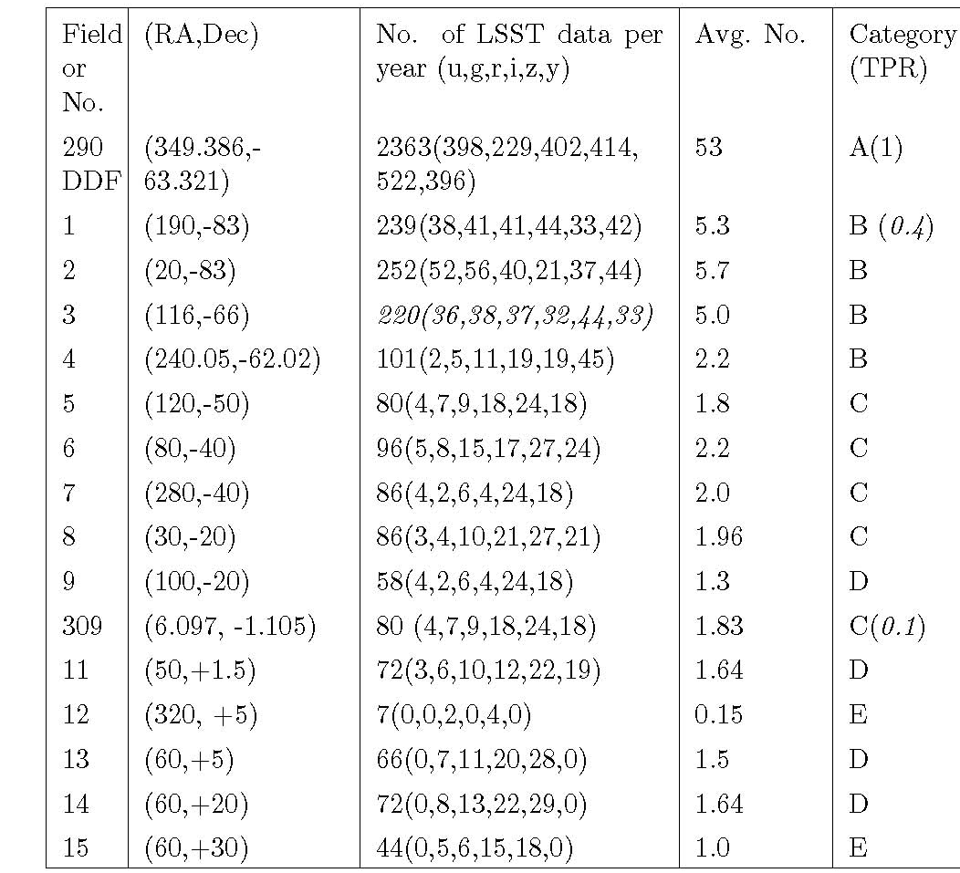
Avg. Data No (goal > 7-9)
Group
Per filter
Per 45 days
>9
A: Very Good
5-9
B: Good
1.5-5
C: useful, but
not good enough
<1.8
D/E: poor

Slide 8
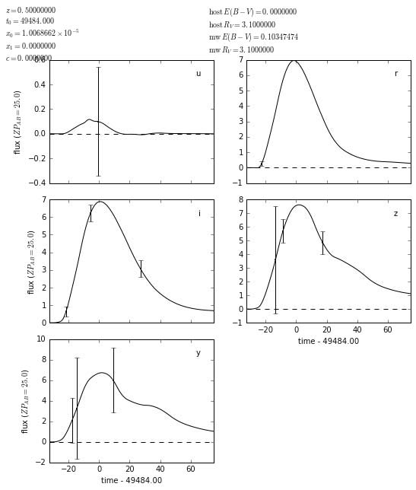
Dec = -40° RA = 280°
Rolling Cadence:
To increase the number of data points
in the light curve to get 7-9 data points
per filter in average.
We need to experiment with SNDM
and SNQM, SNCLASS metric
About dependency of the filter.
◆
◆
◆
◆
◆
◆

Slide 9
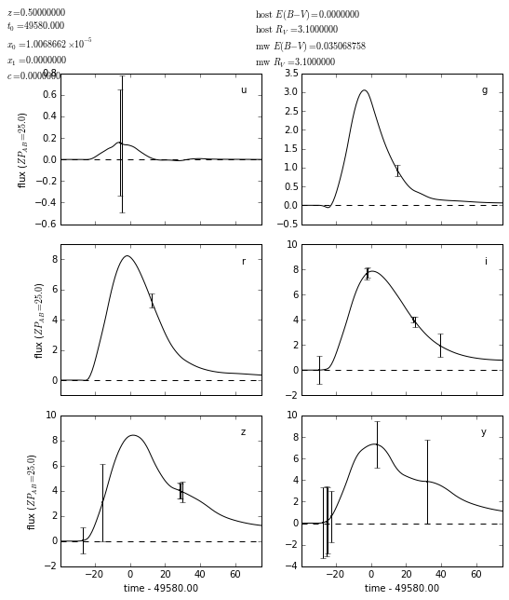
Dec = 0.18° RA = 358°
◆
◆
◆
◆
◆
◆
◆
◆
◆
◆
◆
◆
◆

Slide 10
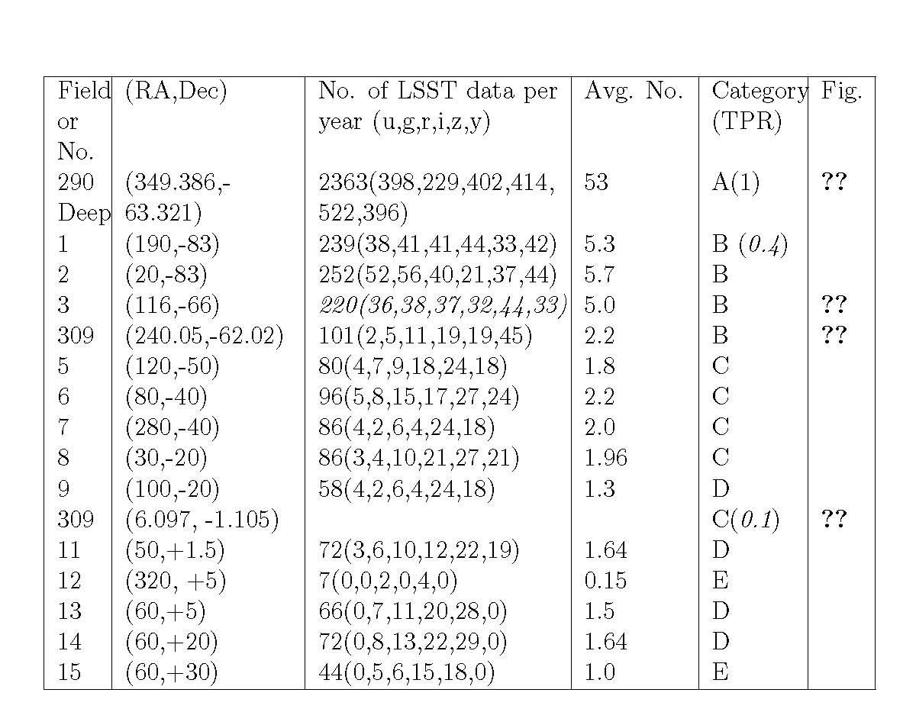
Rolling Cadence:
X2 or X3 sampling
Per filter
Per 45 days
A: >10
B: 10-15
C: 4-8
We focus on
this region
D/E:3-5
accept

Slide 11
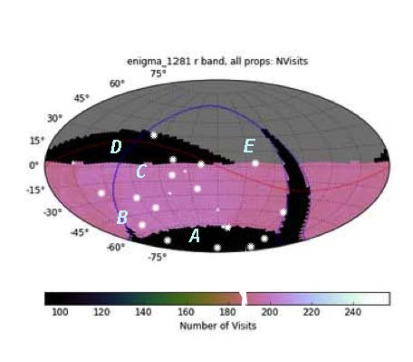

Light Curve category with N visits
(RA,Dec=20,-83)
1yr: 250 (52,56,40,21,37,44)
10yr: 1173 (75, 112, 272,259,223,232)
We will focus on B and C area: New Strategy will Impact
large areas of LSST survey

Slide 12
LSST Baseline observation
The observing strategy of WDF is defined (see Section 1.6.2 in the LSST science book) as follows.
• A revisit time of three days on average per 10,000 deg² of sky (i.e., the area visible at any given time of the year), with two visits per night (particularly useful for establishing proper motion vectors for fast moving asteroids).
We define the 10,000 deg² survey area (the visible sky for a given time of the year) simply as the “visible sky”. LSST can observe 1/3 of visible sky per day for a band.

Slide 13
Rolling Cadence: to increase the sampling rate x2 or x3
Change Revisit time from 3 days to 1 day (1/3 of three days above) on average visible sky.
This means one third of the visible sky (∼3300 deg²) can be chosen. Preference may be given to the part of sky with low air-mass, but at the same time a uniform coverage of LSST needs to be considered.
Observe the same part sky (3300 deg²) for the period of SN Ia, 50 days using 6 filters : this will generate 8-9 data points per filter.
After 50 days observing 1st part of sky, go to 2nd part of sky and observe for 50 days
After 50 days, go to 2nd part of sky and observe for 50 days
After 150 days observing runs, the area and the filter coverage should be the same between the baseline plan and suggested rolling cadence.

Slide 14
Rolling Cadence Optimized for SN Cosmology
Observe 1/3 available sky (compared to the current) and concentrate on this field
assuming one data point per day
6 filter x(7-9 data points) = 50 days
- Observe 2nd 1/3 available sky: 50 days
- Observe 3rd 1/3 available sky: 50 days
- practically 3 filter x (7-9) + 3 filter x4= 36 days)
Apply outside the Galactic Plane: |l| > 30°
Improve LC quality of Group B and C area.

Slide 15
What is observing strategy to make x2 or x3 factor higher sampling in light curves?
49484
Goal: Avg data points > 7-9
Observe a smaller area (for example 1/3) and observe 3 times frequently (compared to the current plan).
?

Slide 16
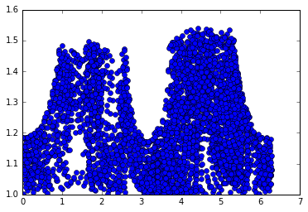
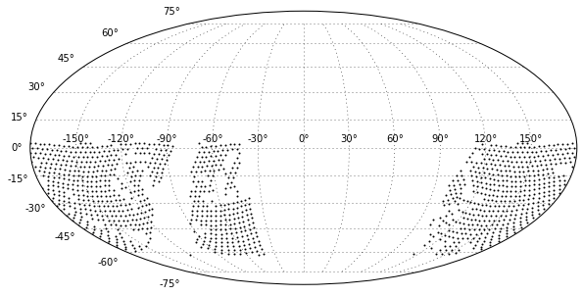
MJD49492-49498: 6 day observing run
airmass
49484-49491: deep fields
Y band : 6 days
I band: 3 day
z band: 3 day
Azimuth

Slide 17
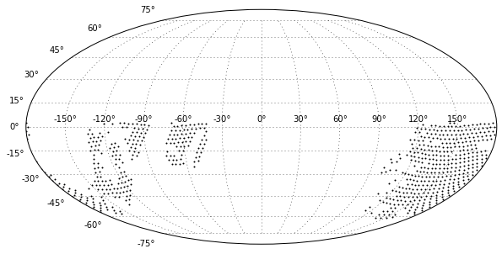
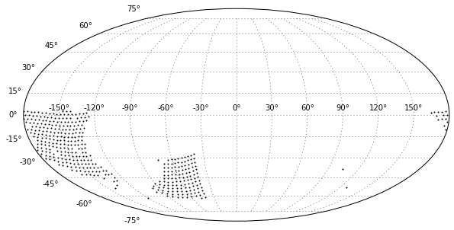
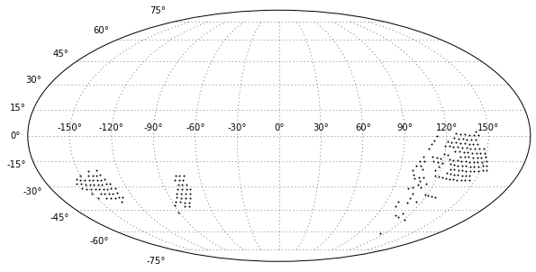
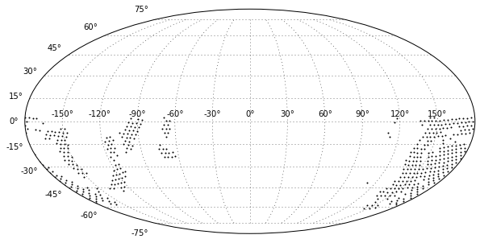
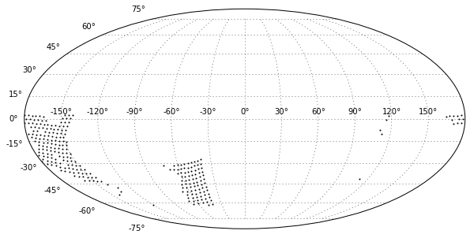
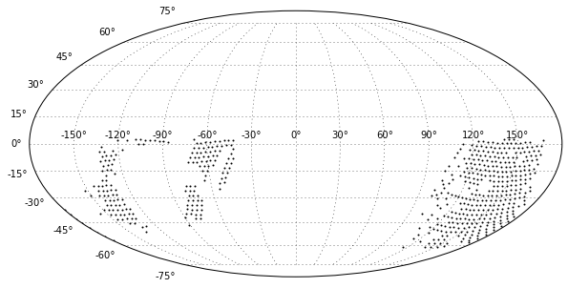
49492-49498 (y band)
Total 6 day
day 3
Day 6
✪
49495
49498
airmass
day 1
day 4
49496
49493
day 2
day 5
Azimuth
Let’s observe only
high elevation sky
49494
49497
yband

Slide 18
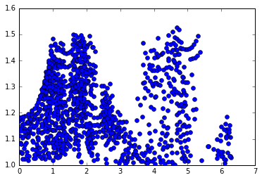
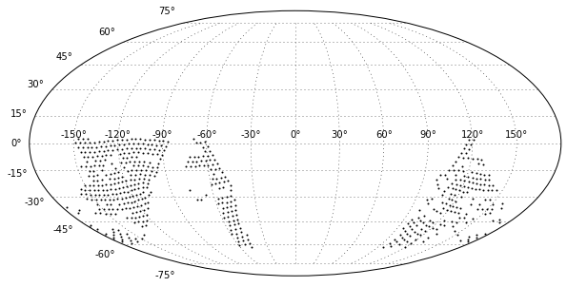
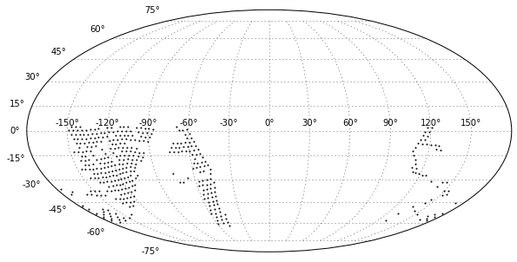
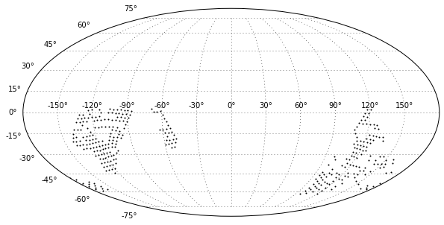
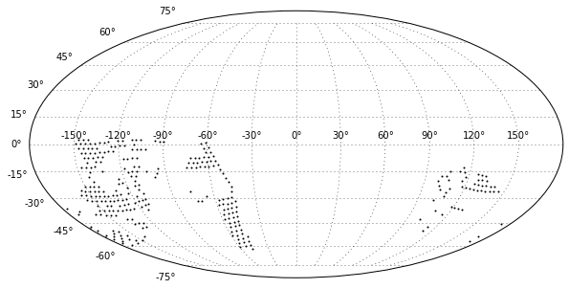
iband
3days: 49490-49492
Total 3 day
day 2
49491
day 1
day 3
✪
49492
49490

Slide 19
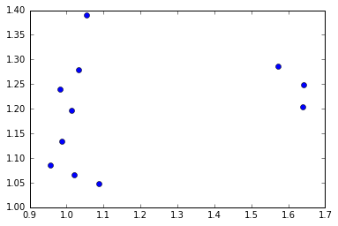
3days: 49490-49492
Take the sky which gives lower airmass
Method 2: modify selection of the region with lower airmass
day 1: y band
Day 2: i band
day 1: z band
Ir, I, z band for each day
Take the 1/3 sky which gives lower airmass
Observe more horizontally rather than vertically, which results in less variation in airmass.
iband

Slide 20
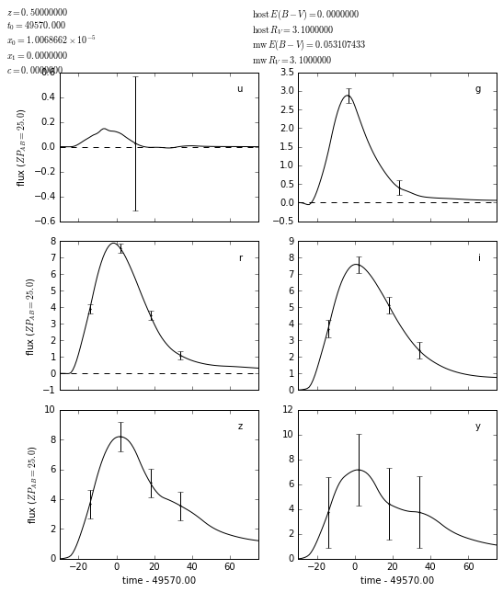
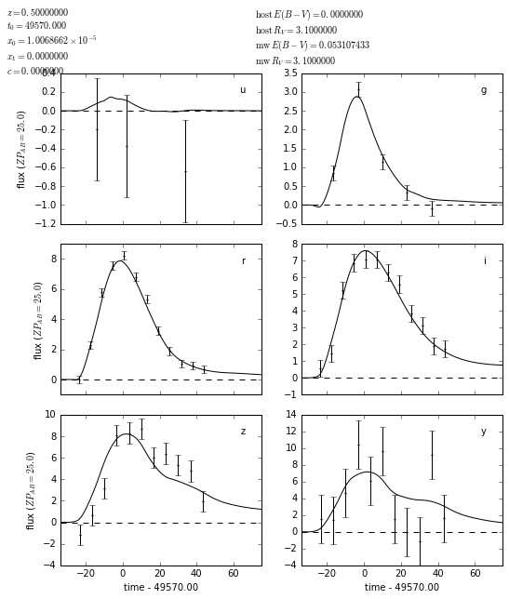
Cadence LC (x3): RA=58, Dec=-27
New estimate DM, QM, CLASS?
Random Seed
Random seed

Slide 21
Status of Observing Strategy
LSST project is working on updating Opsim run for users to allow to vary these options.
New version is expected by the end of Nov.
Need to experiment various rolling cadence with new opsim.
At the moment, it is not clear about status of white paper (it has been stopped) since the LSST team is busy with updating opsim runs etc.

Slide 22
End

Slide 23
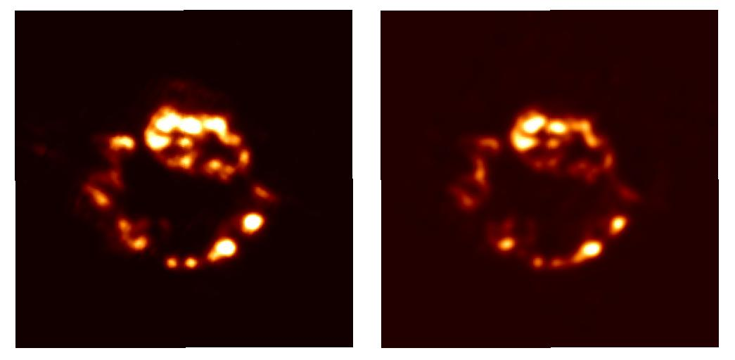
Cas A: Dust formation in the SN ejecta
21μm dust map which is continuum map of 19-23μm subtracted by the baselines of neighboring wavelengths.
[Ar II] 7μm map (the resolution is convolved to match): remarkably similar to the dust map.

Slide 24
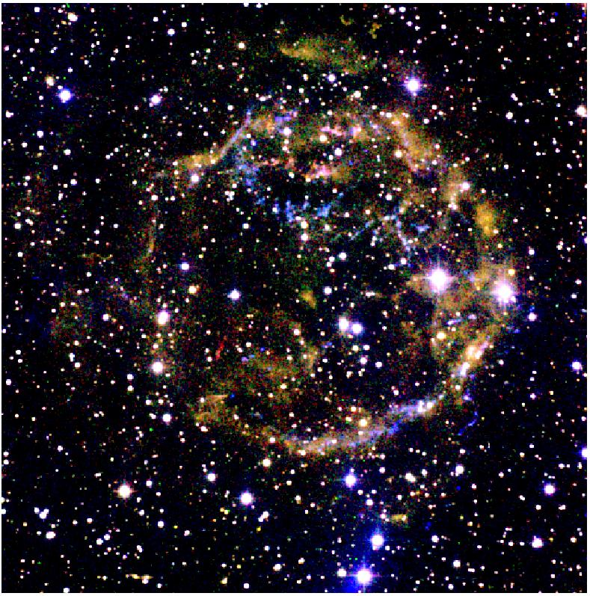
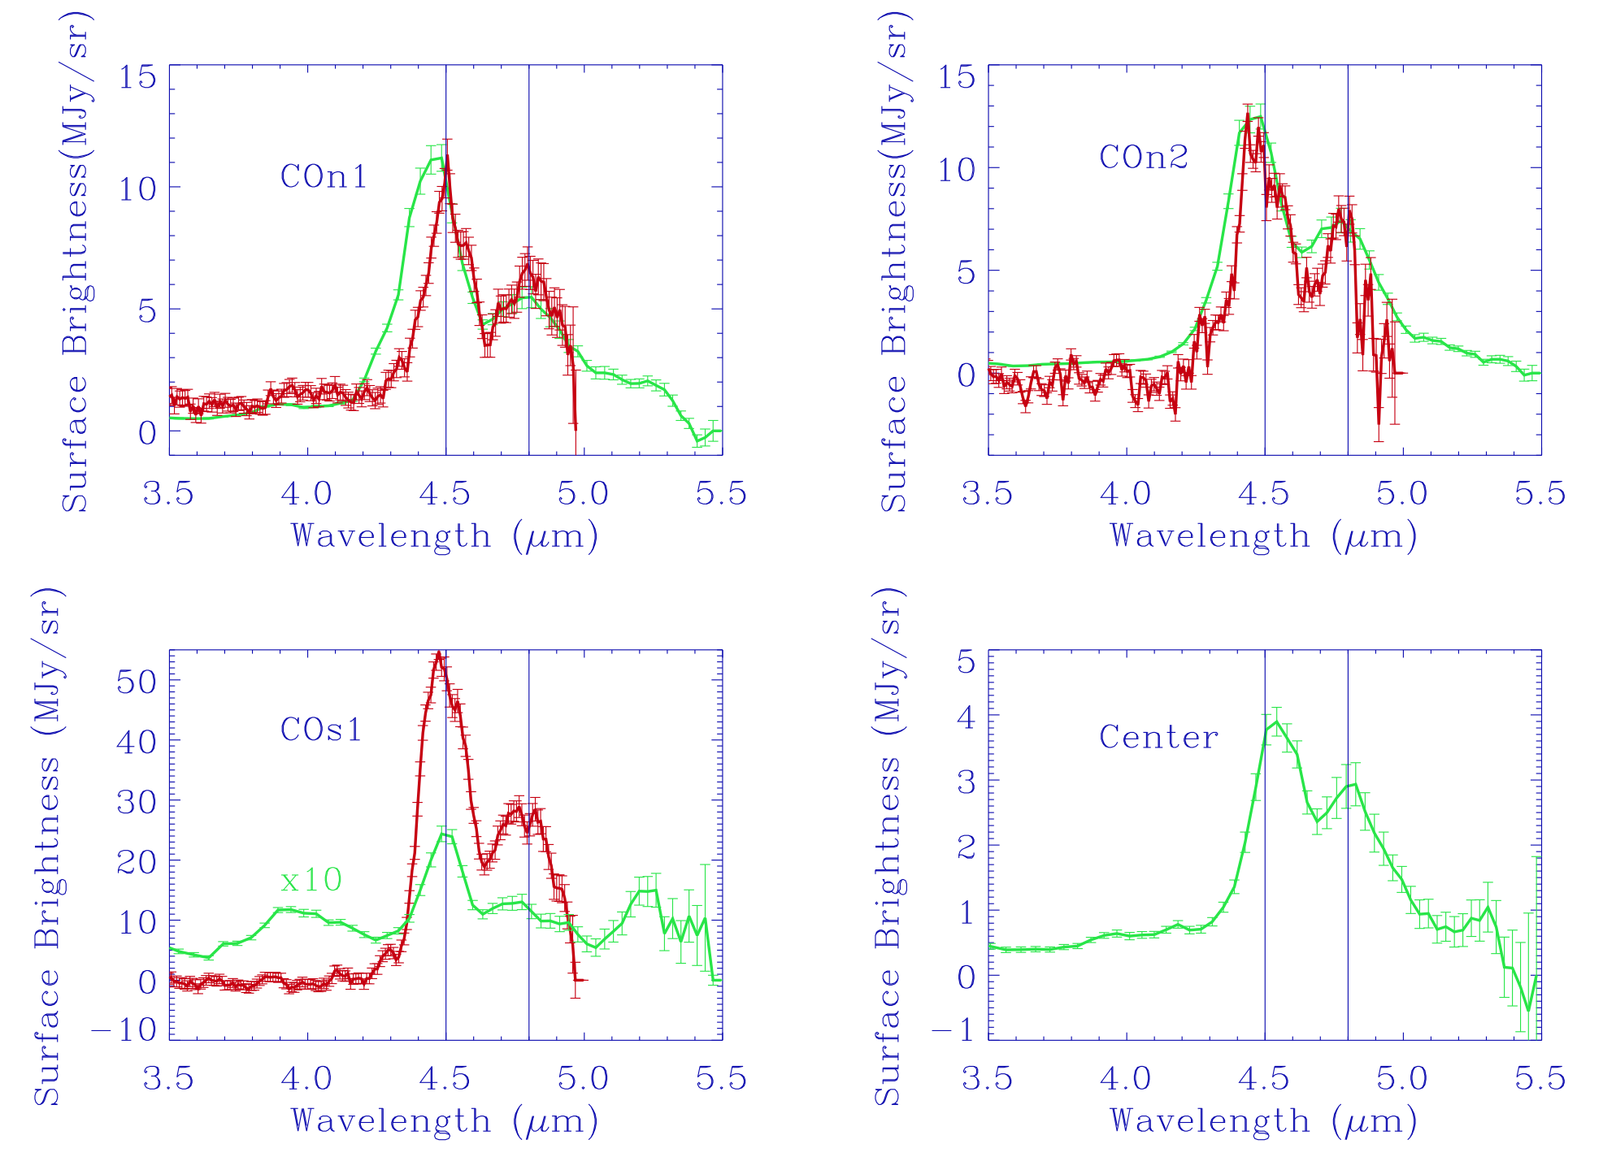
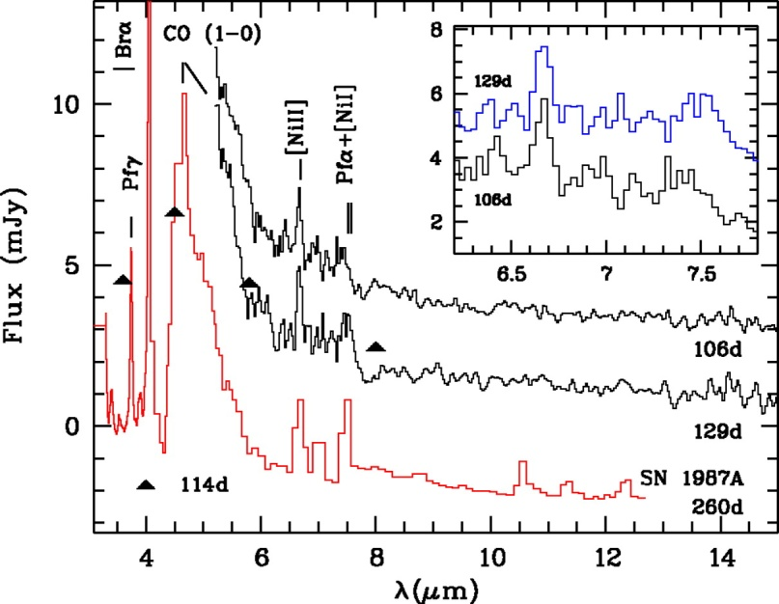
CO detection in Imaging and Spectra
AKARI Fundamental CO lines
Rho et al. (2012)
Near-IR imaging:CO filter (red): 2.294µm K-cont (green): 2.27µm Pβ(blue):1.182µm
CO from SNe (Kotak et al. 2006)
First Overtone CO detection Rho et al. (2009)

Slide 25
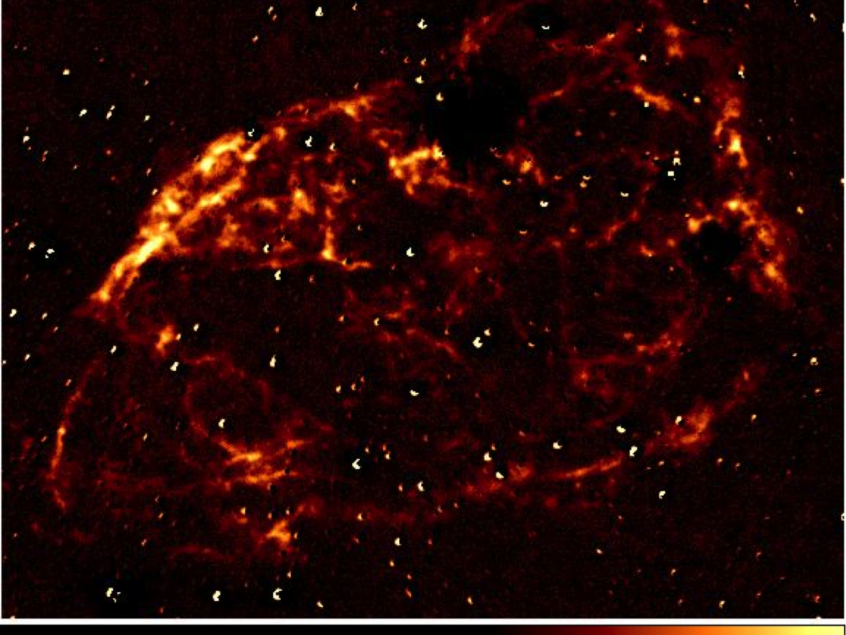
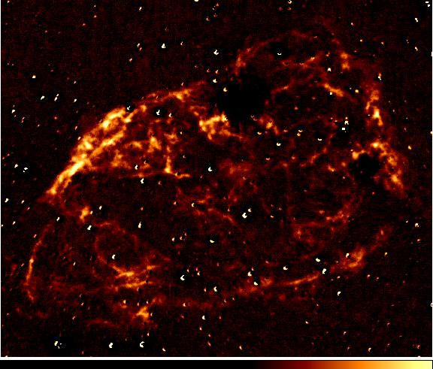
SN Ia progenitor: 3C397
Near-IR Fe image: Higher Fe abudance in SN Ia (Rho et al., in prep)

Slide 26
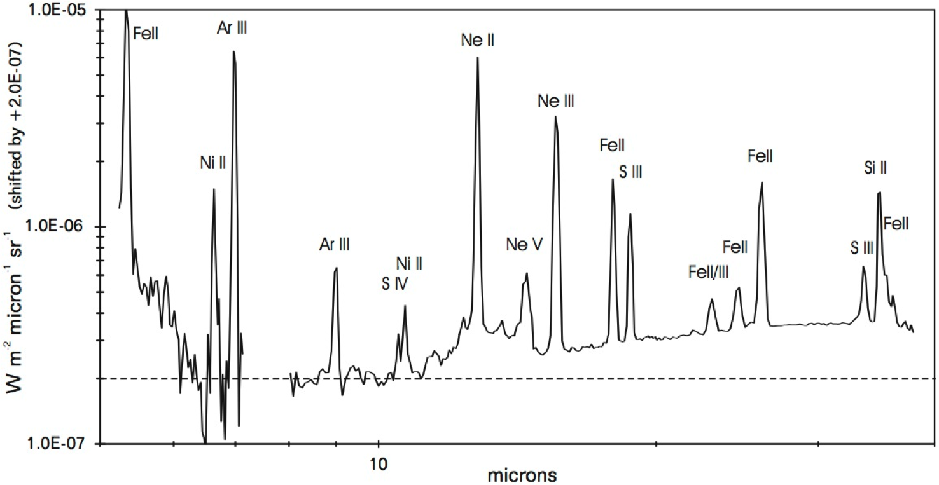
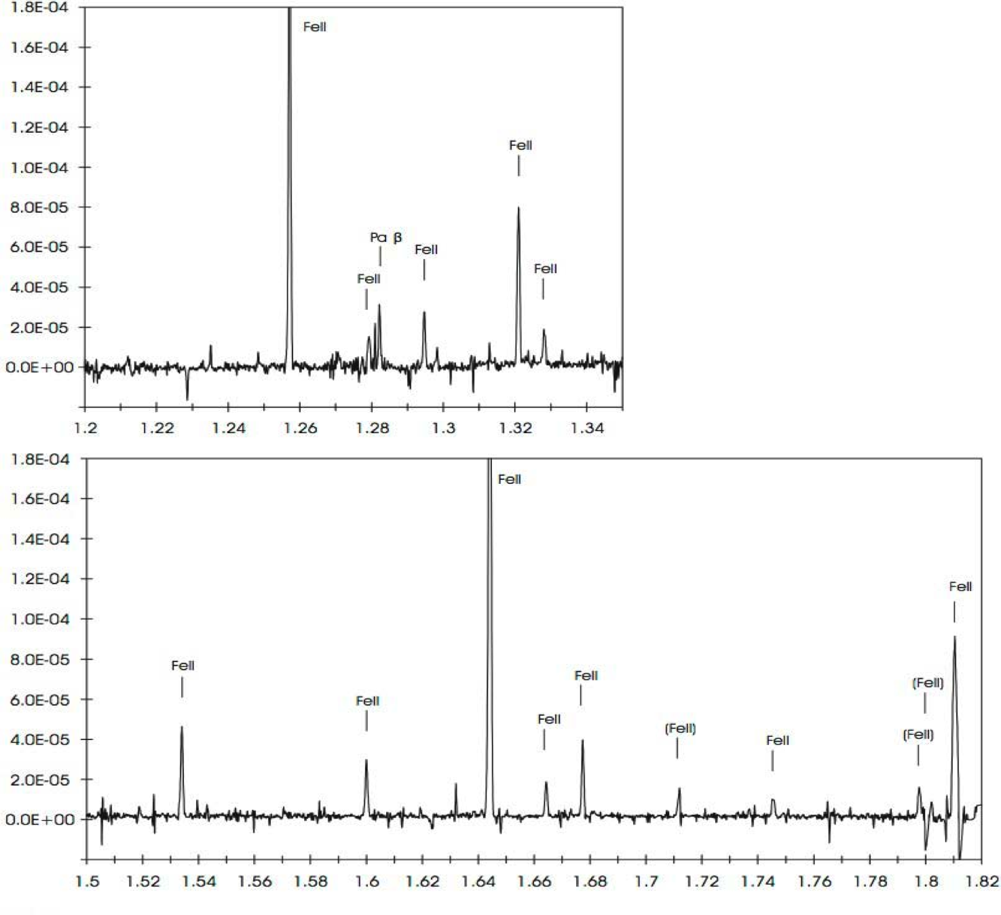
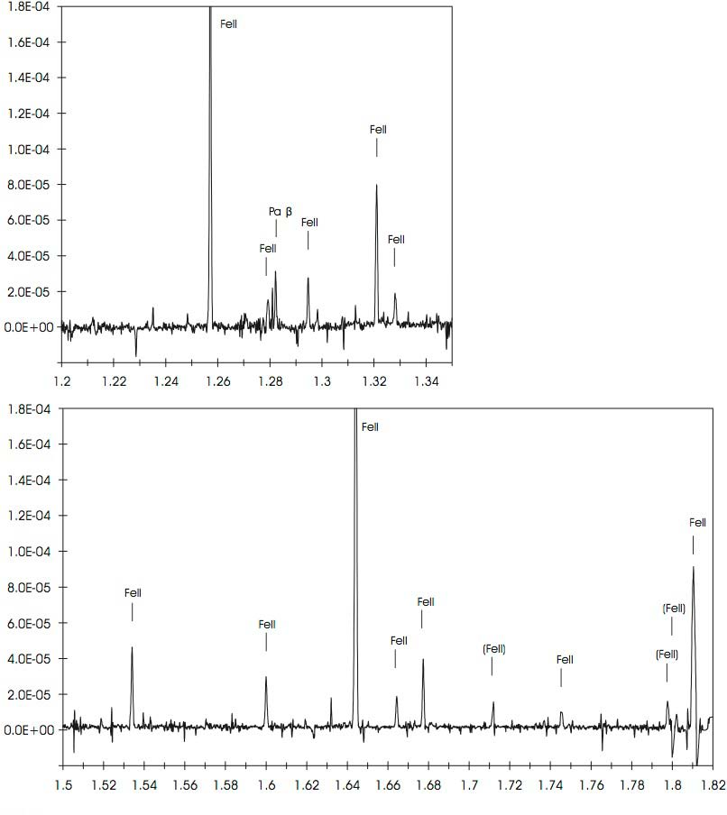
The best-fit parameters of Fe model
are T = 7000 K and n_{e} = 8200 (5000-1.2x10⁴) cm⁻³.
Near-IR and Spitzer Spectroscopy

Slide 27
iband
3days: 49490-49492
Method 1
Day 1: r band
Day 2: l band
Day 3: z band
r, I, z band for each day for the same field
Day 52: l band
Day 53: z band
Day 51: r band

Slide 28
Hard Questions?
What bands do we want to increase (priority)?
r, I and z band if we focus on SNe at z=0.5
What is optimal fudge factor to stay at the same field (f) to maximize detection of the number of SN Ia?
(38+f_{add})[or 48]x fudge factor (f)
We can regenerate LC eventually with OpSim output
What are fast, simple way to add the data points?
- Add with random function
- merge two light curves
- Any suggestion?
Eventually New OpSim run is needed (at least 4-5 months and possible 1 year according to Zeljko (OpSim team plans to work on this).
But in the meantime, what test can we do?

